Slide 1
Production and cost
Module 2

Slide 2
Production: Process by which inputs are transformed into output
Production function: Functional relationship between inputs and output
Q= f(L, K, N, T)
L- labour
K- capital
N- natural resources
T- technology

Slide 3
Short run production function/variable proportion
- production can be increased by increasing quantities of variable factors
- factors like machinery and building are considered as fixed; quantity remains constant
-proportion in which variable and fixed factors are combined, changes
Long run production function/fixed proportion
- production can be increased by increasing quantities of all factors in same proportion
-all factors are variable

Slide 4
Law of variable proportion (also called Returns to a factor/Production function with variable input)
Describes changes in output when more and more units of one variable factor is employed while keeping quantities of others constant
Total product of a factor (TP)- total physical output produced using certain quantity of a factor
Marginal product of a factor (MP) – addition to total product by employing one more unit of a factor
Average product of a factor (AP) – output per unit of factor employed
APL=TP/L

Slide 5
Law of variable proportion
When more and more units of one variable factor is employed with fixed quantities of other factors, initially, MP increases, then it decreases, and finally, it becomes negative
i.e. TP increases at an increasing rate first, then increases at decreasing rate and finally, starts declining

Slide 6
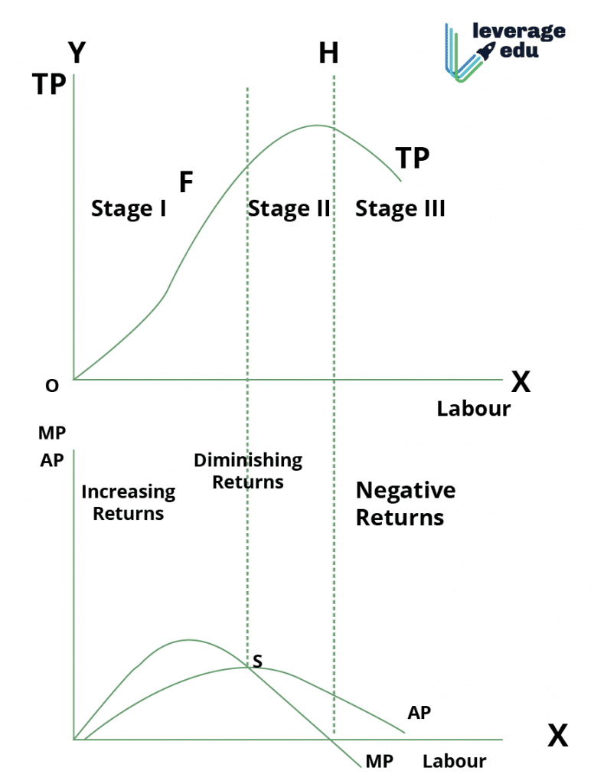
Units of labour | TP | MP | AP
1 | 8 | 8 | 8
2 | 18 | 10 | 9
3 | 30 | 12 | 10
4 | 40 | 10 | 10
5 | 45 | 5 | 9
6 | 48 | 3 | 8
7 | 49 | 1 | 7
8 | 49 | 0 | 6.1
9 | 45 | -4 | 5
10 | 40 | -5 | 4
Land is fixed, labour is changing

Slide 7
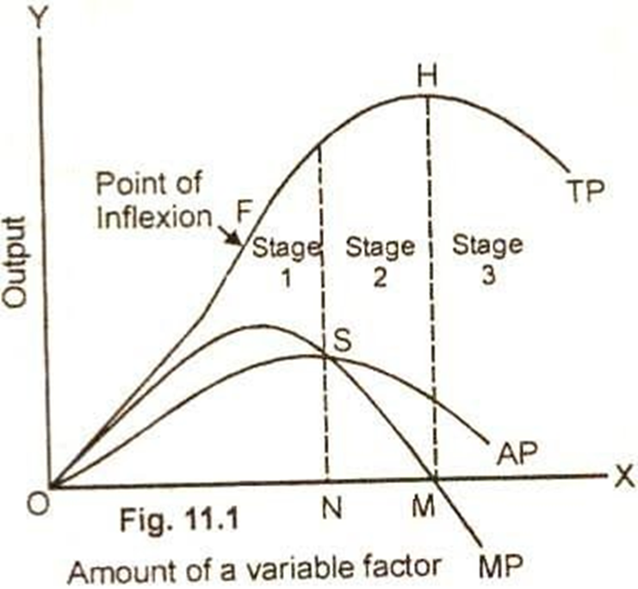
Stage 1: stage of increasing returns
When MP increases, TP increases at an increasing rate upto a point
The point F where the TP stops increasing at an increasing rate and starts increasing at the diminishing rate is called the point of inflection. MP is maximum at this point. First stage continues till AP=MP
Stage 2: stage of diminishing returns
MP decreases, so TP increases at a diminishing rate. Second stage continues till MP=0
Stage 3: stage of negative returns
MP becomes negative and TP starts declining

Slide 8
Relation between…
MP and TP
When MP increases, TP increases
When MP decreases, TP increases at a decreasing rate
When MP is negative, TP declines
MP and AP
When MP>AP, AP increases
When MP=AP, AP is maximum
When MP<AP, AP decreases

Slide 9
Assumptions of law of variable proportion:
All units of the variable factor are equally efficient
Technology remains constant
Proportion of inputs can be varied

Slide 10
Returns to scale (Fixed proportion/Long run product function)
Describes the changes in output when the inputs are varied in the same proportion
When all inputs are varied in the same proportion, initially producer gets increasing returns to scale, then constant returns to scale, and finally decreasing returns to scale

Slide 11
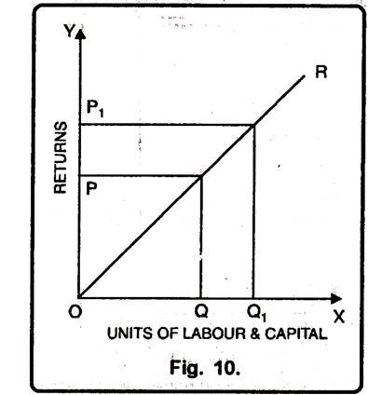
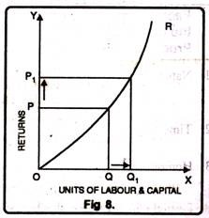
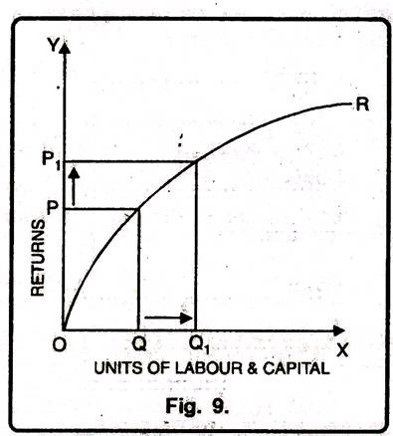

Slide 12
Economies of scale
Refers to advantages of large scale production which help reduce average cost of production
Production is expanded by increasing inputs, to attain some advantages
Internal economies (within the company)
External economies (common to companies in an industry/group of industries)

Slide 13
Internal economies
Labour economies- enables division of labour – more efficient; better prospects, so more efficient labour
Technical economies – shifting to latest tech increases efficiency and reduces cost of production, and time
Managerial economies – specialist managers for different departments-increases efficiency
Marketing economies –large scale marketing reduces average marketing expenses
Financial economies – easier for larger firms to loans as they are viewed as less risky
Risk minimising economies – risk can be minimised by diversification of output/markets

Slide 14
External economies
-Economies of localisation- firms under same industry located in same place can enjoy mutual advantages – availability of skilled labour, better transport, supply networks , power supply
- Economies of information –market information will be more accurate – for e.g. price: suppliers cannot charge different prices
- Economies of vertical disintegration – enables establishing subsidiary industry to fulfil needs of main industry
- Economies of by-product – enables starting of firms that use the by-products of the industry

Slide 15
Diseconomies of scale- Disadvantages of large scale production
Beyond a certain point,
Difficulties of management
Difficulties of coordination
Difficulties in decision making
Communication problems
Labour diseconomies
Scarcity of inputs
Marketing diseconomies

Slide 16
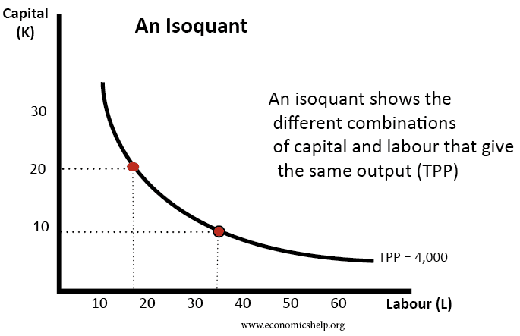
Isoquants
Curve showing combination of two inputs which give the same level of output
Units of labour | Units of capital | Output
10 | 30 | 4000
20 | 18 | 4000
30 | 12 | 4000
40 | 8 | 4000
Iso=equal
Quant=quantity

Slide 17
A curve, which when plotted on a graph, shows all combinations of two factors that produce a given output
Assumptions –
- only 2 factors
-2 factors can substitute each other upto some limit

Slide 18
Isoquants..
Properties:
Negatively sloped- when one factor is increased, the other is decreased to keep output constant
Convex to origin- Due to falling MRTS (marginal rate of technical substitution)- i.e the amount of capital replaced by the additional unit of labour – L,K not perfect substitutes
Two isoquants never intersect
Higher isoquants represent higher output

Slide 19
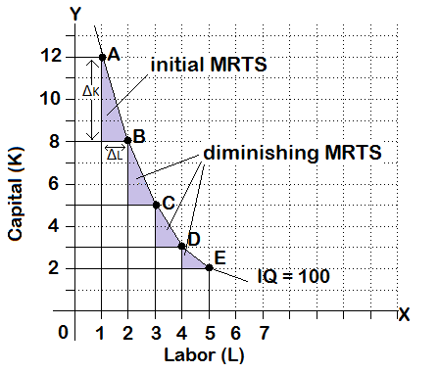

Slide 20
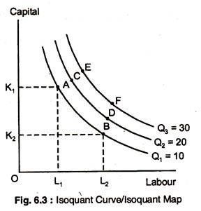
Isoquant map

Slide 21
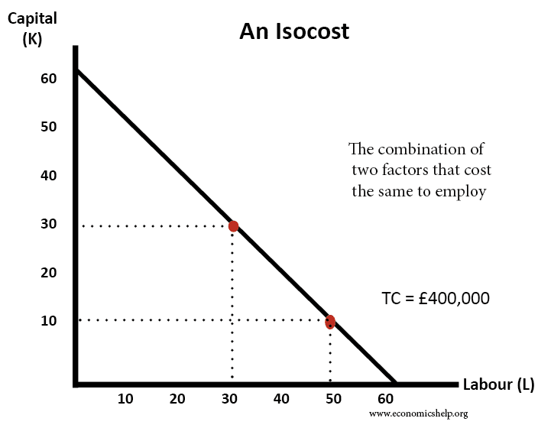
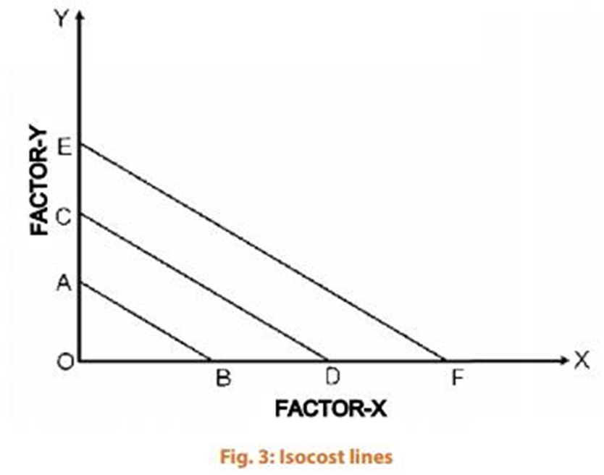
Isocost line
A curve that shows various combinations of inputs that cost the same total amount
Lower isocost curve is better for
producer

Slide 22
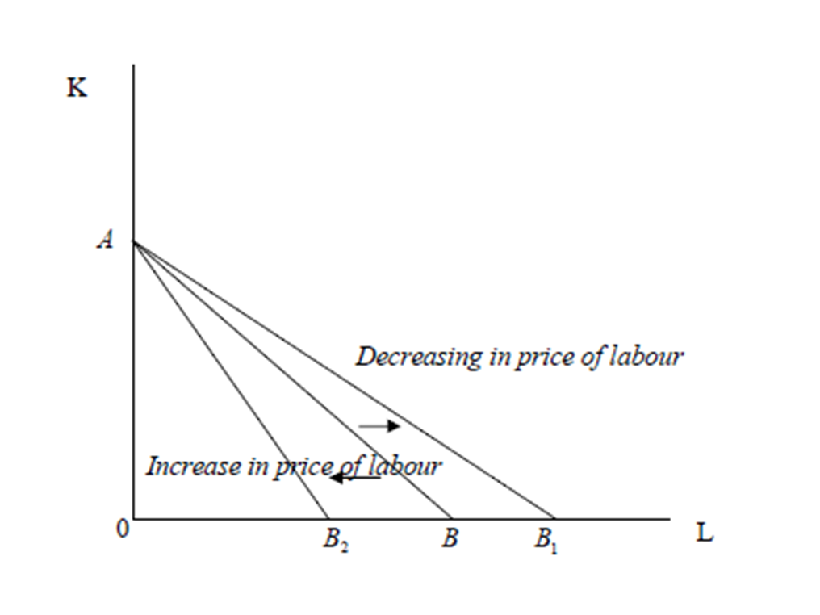

A firm’s isocost line can shift if there is (a) a change in total expenditure of the firm on inputs (change in outlay) and (b) change in price of the inputs.

Slide 23
Producer’s equilibrium
When producer is able to produce a given quantity of output with least cost or when he produces maximum output with a given amount of inputs
Least cost combination of inputs to produce a certain quantity of output
Attained at the point where isoquant is tangent to isocost line

Slide 24
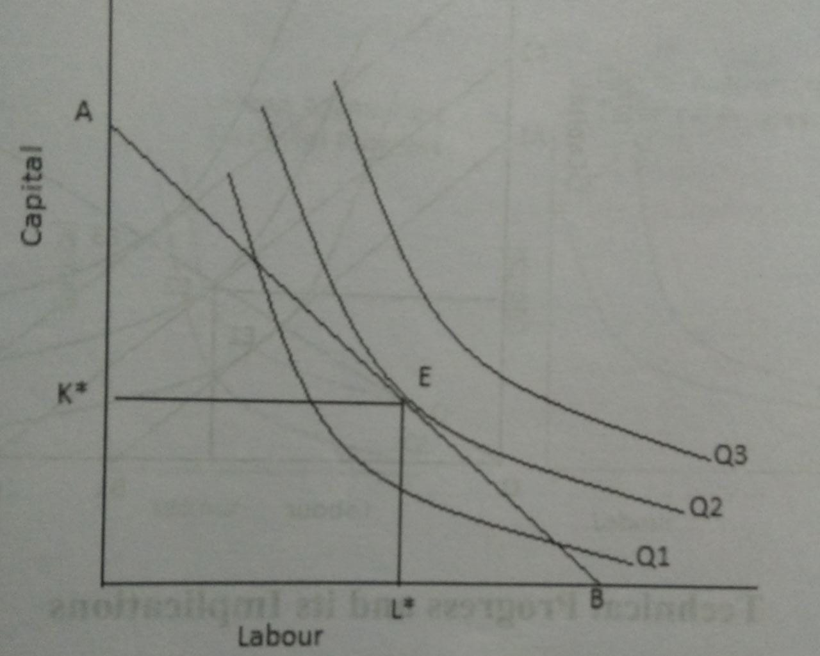
Producer is in equilibrium at E where isoquant is tangent to isocost line.
Q2 quantity is produced at the least price

Slide 25
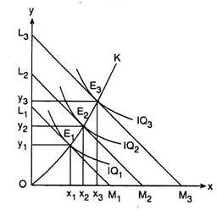
Expansion path
A line connecting optimal input combinations as the scale of production expands
Long run concept which provides
least cost input combinations at
different levels of output
Expansion path obtained by joining
points of tangency between isocost
lines and isoquants

Slide 26
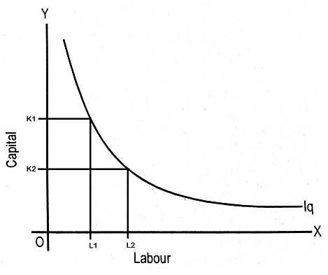
Technical progress and its implications
Change in technical progress leads to change in production function - More output is produced using same level of inputs
Isoquant shifts downwards

Slide 27
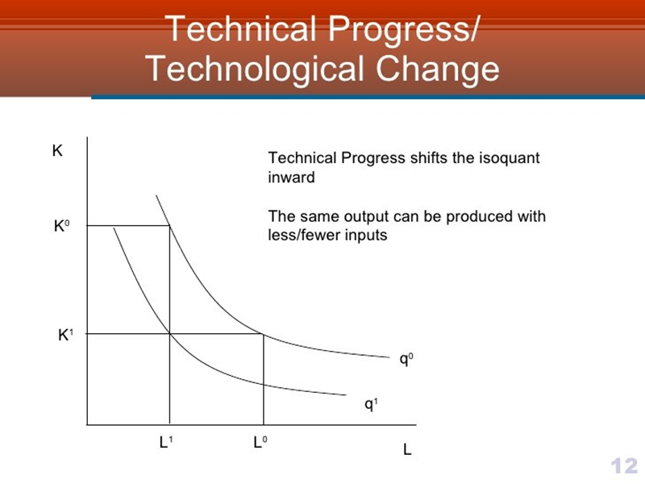

Slide 28
Three types of technological progress:
Neutral technological progress: change in MP of L and K due to technical progress are the same
Labour augmenting technical progress: MP of L increases faster than MP of K
Capital augmenting technical progress: MP of K increases faster than MP of L

Slide 29
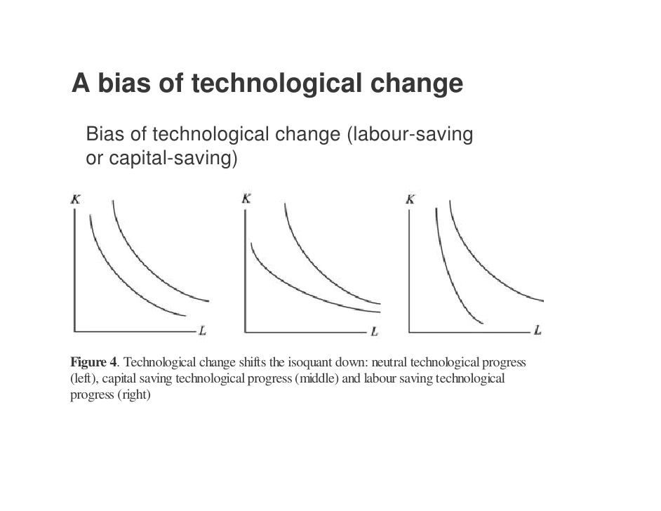

Slide 30
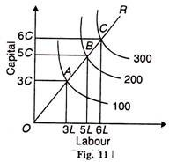
Returns to scale using isoquants
Increasing returns to scale – output increases at a greater proportion than increase in inputs

Slide 31
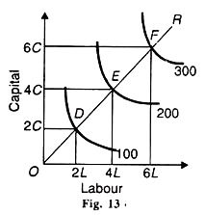
Constant returns to scale
Inputs and outputs increase at the same proportion

Slide 32
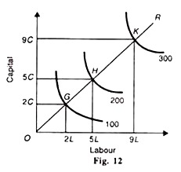
Decreasing returns to scale:
Output increases at a lesser proportion than the increase in inputs

Slide 33
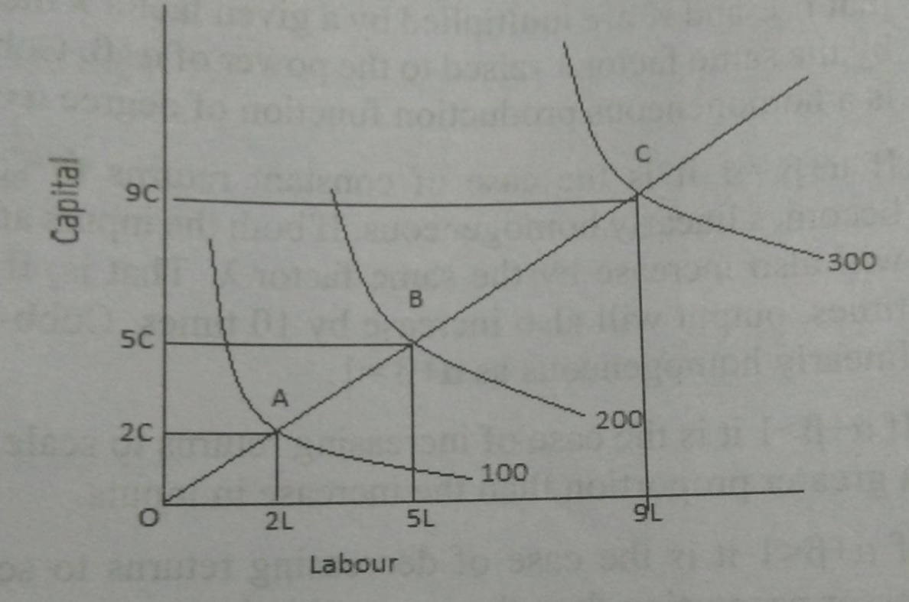
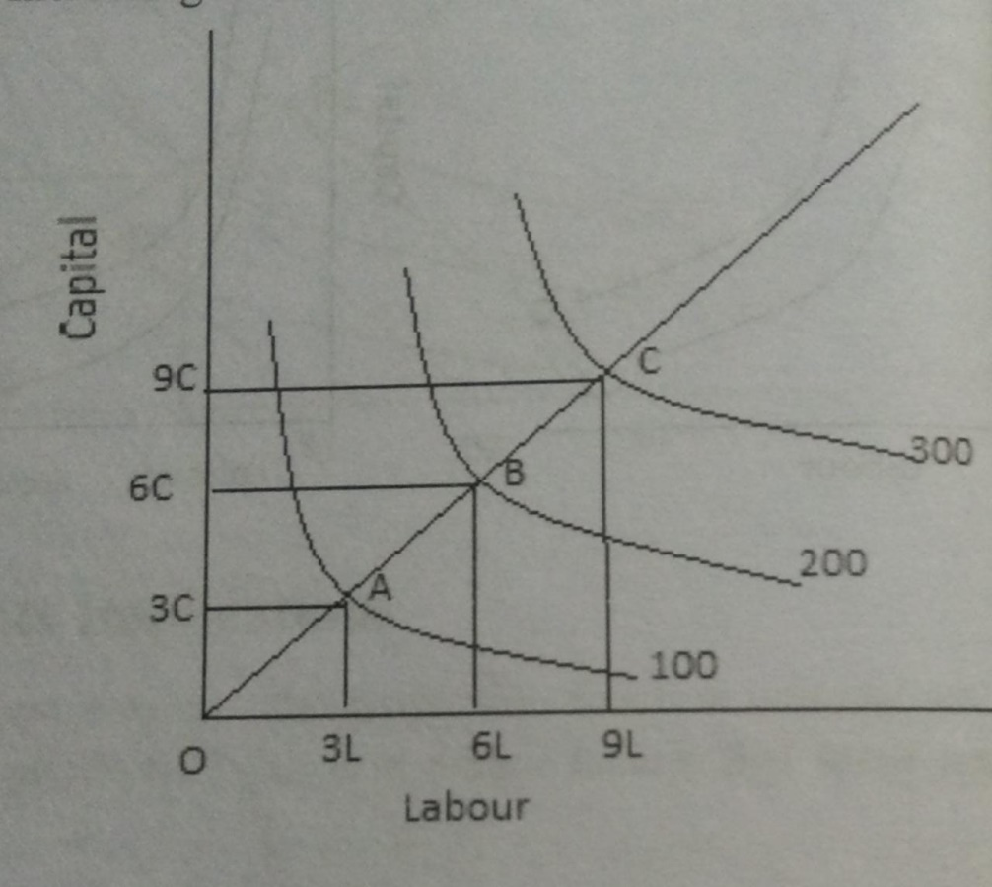
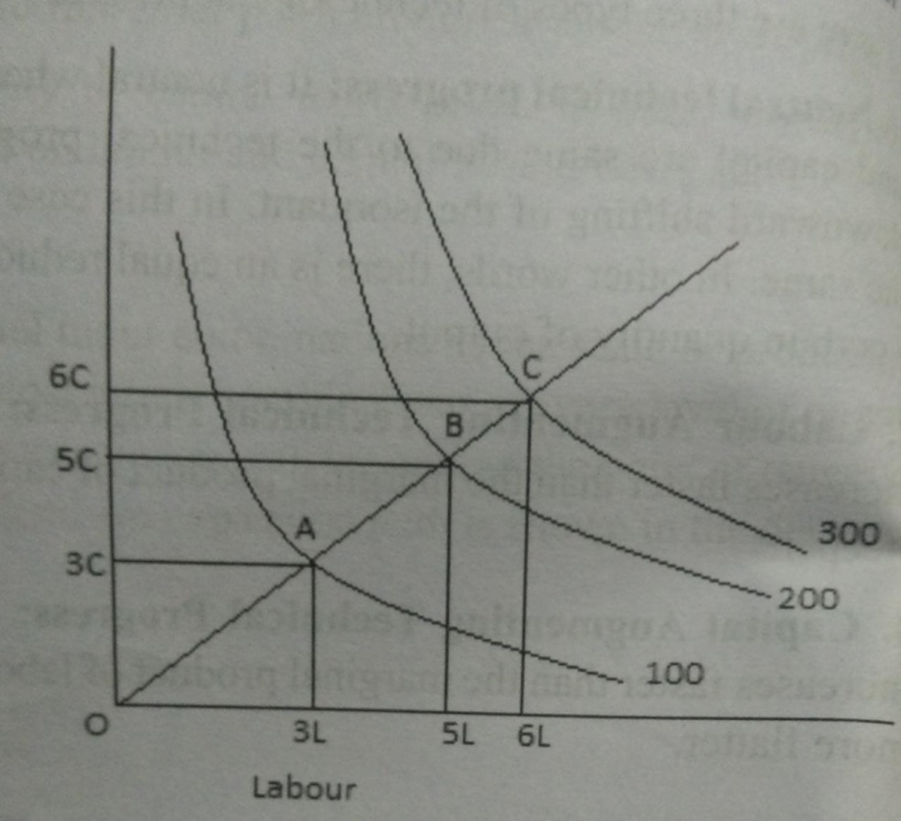
Increasing returns to scale
Decreasing returns to scale
Constant returns to scale

Slide 34
Cobb-Douglas production function
Represents the technological relationship between quantities of two inputs, capital and labour, and the amount of output that can be produced by those inputs
Proposed by Knut Wicksell, developed by Charles Cobb and Paul Douglas
Q=AL^{α} K^{β}
Q= total output
A= total factor productivity – (positive constant)
output elasticities of labour and capital are denoted by α and β respectively
α = contribution of labour
β = contribution of capital

Slide 35
Suppose Q=2K^{1/2}L^{1/2}
(a) Find output when K=16, L=36
Ans: 48
(b) How many units of capital are required to produce 40 units of output, if L=25
Ans: 16

Slide 36
Let Q=3K^{1/2}L^{1/2}. Labour was increased by 10%. Find the resulting percentage increase in output
Ans: 5%

Slide 37
Consider Q=2L^{1/2}K^{1/2} and L= 36. How many units of K are needed to produce 60 units of output?
Ans: 25

Slide 38
Cost concepts
Explicit costs
Expenses actually met by the producer while producing a commodity
Payments are actually made by the producer to outsiders who supply labour, raw materials, electricity
Recorded in the books of accounts
Implicit costs
Opportunity cost of the factor services supplied by the organisation itself e.g. a firm running in its own building
Not recorded in books of accounts

Slide 39
Real cost
Actual pain and suffering involved in the production of a commodity.
Leisure or time with family is sacrificed by a person involved in the production of a commodity
Cannot be measured in terms of money
Psychological in nature

Slide 40
Accounting cost
Money cost that can be recorded in the books of accounts.
Same as explicit cost
Social cost
Sum of private cost and external cost
Pvt cost- cost incurred by producer in production of a commodity- buying/hiring factor services
External cost - Damages caused to environment in the form of air pollution, water pollution, etc. met by the society

Slide 41
Replacement cost
Cost incurred when an asset depreciates and is replaced with a new one.
There is no increase in total assets
Sunk cost
Cost already been incurred and cannot be recovered
e.g. abandoning an oil well – money spent on it is lost forever

Slide 42
Implicit
Explicit
Real
Accounting
Social
Replacement
Sunk

Slide 43
Short run and long run
Short run: Output can be increased only by varying variable factors – labour, raw material. Fixed factors – bldg, machinery do not change
Long run: Output can be increased by increasing all factors. All factors are variable

Slide 44
Short run costs
Certain factors are fixed, certain others are variable. So firm incurs both variable and fixed cost
TFC, TVC, TC, AVC, AFC, AC, MC

Slide 45
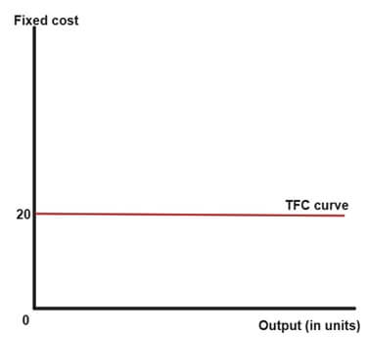
TFC –Total Fixed Cost
Cost which does not vary with the level of output
Needs to be incurred even at zero output
e.g. rent, interest, salary of permanent workers

Slide 46
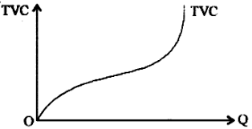
TVC – Total Variable Cost
Cost that varies with level of output
When output is zero, variable cost is also zero
e.g.cost of raw materials, wages, transportation cost, fuel
S shape due to law of variable proportion

Slide 47
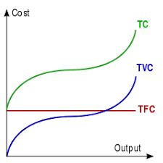
TC - Total cost
TC= TVC +TFC
Same shape as TVC
Starts from starting point of TFC

Slide 48
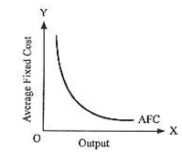
AFC – Average fixed cost
The fixed cost per unit of output
AFC = TFC
Q
Downward sloping

Slide 49
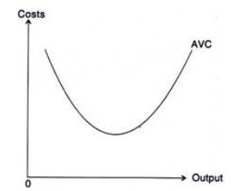
AVC – Variable cost per unit of output
AVC = TVC
Q
U shaped

Slide 50
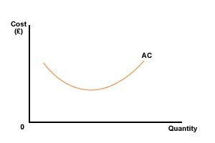
AC – Average Cost
Cost per unit of output
AC = TC
Q
= TFC + TVC
Q Q
= AFC+AVC

Slide 51
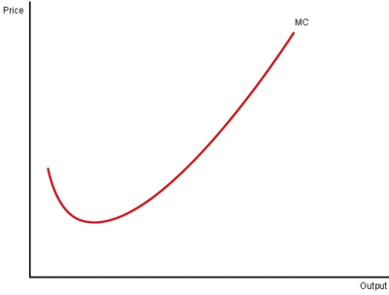
MC – Marginal cost
Addition to the total cost when one more unit of output is produced
MC = ∆TC
∆Q

Slide 52
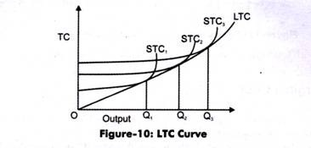
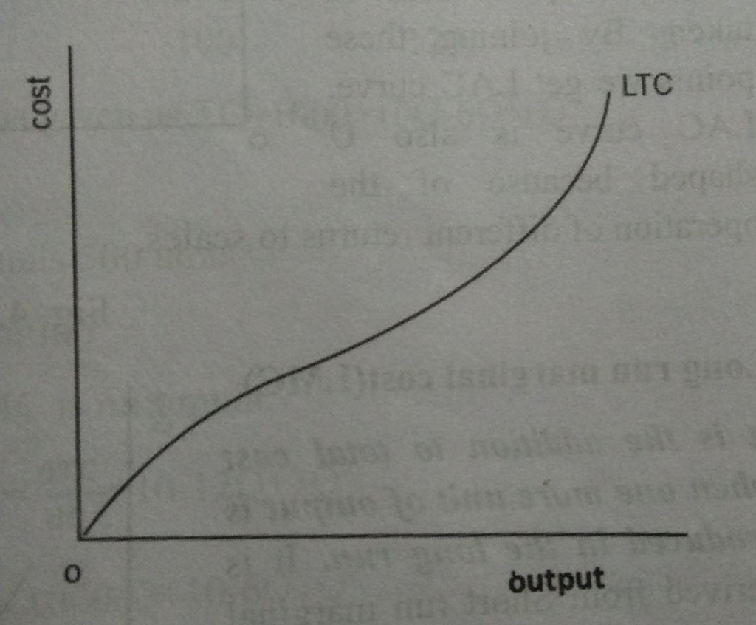
Long run cost
All factors are variable hence there is no fixed cost
LTC - Long run total cost
Minimum cost at which a given level of output can be produced in the long run
Derived by joining minimum points of the STC curves at different levels of output.
Inverse S shape due to returns to scale

Slide 53
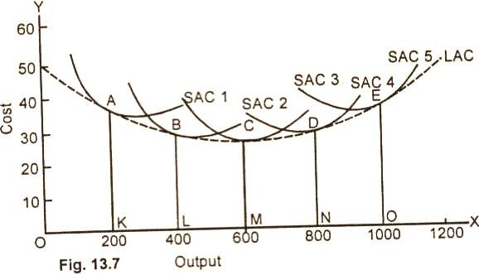
LAC – Long run average cost
Also called ‘envelope’ curve
Cost per unit of output in long run
Derived from SACs
Each SAC represents a different level of output /a different plant size
U-shaped due to economies of scale initially and diseconomies later

Slide 54
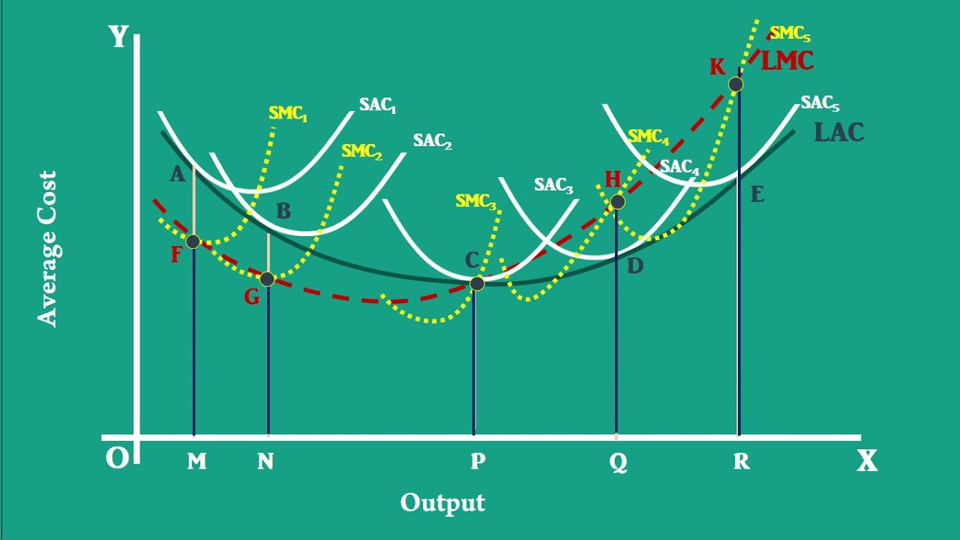
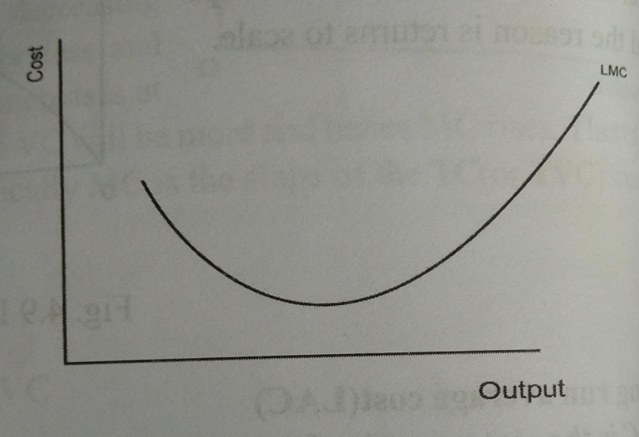
LMC – Long run marginal cost
The addition to the total cost when one more unit of output is produced in the long run
Derived from SMC curves

Slide 55
Revenue
Revenue:The income from the sale of output
TR – Total revenue
Total receipts from the sale f a given quantity of output
TR = P x Q,
where Q= quantity sold
P = price per unit

Slide 56
AR – Average revenue
Revenue per unit of output sold
AR=TR
Q
= PxQ = P
Q
Thus, AR = P or AR is the price

Slide 57
MR – Marginal revenue
The addition to the total revenue by selling one more unit of output
MR = change in revenue or dTR
change in output dQ

Slide 58
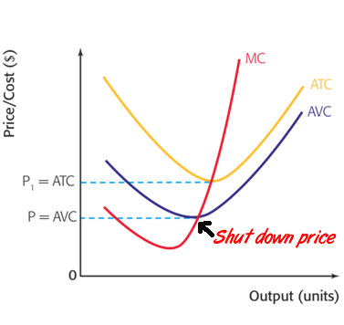
Shut down point
Level of operations from which the company experiences no benefit and decides to shut down operations
The output at which price equals AVC
P=AVC or AR=AVC
P=Minimum AVC

Slide 59
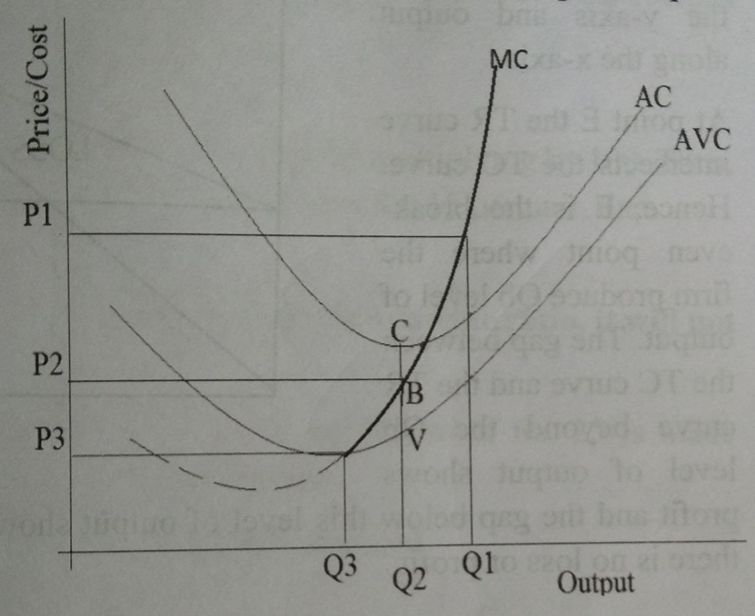

Slide 60
Break even point
Break even analysis: A method used to analyse relationship between TC, TR and profit of an organisation at different levels of output
Break even point: Point at which TR=TC i.e. point at which there is no profit/loss for the firm
Q | TC | TR
1 | 150 | 100
2 | 200 | 150
3 | 300 | 300
4 | 350 | 400
5 | 400 | 450

Slide 61
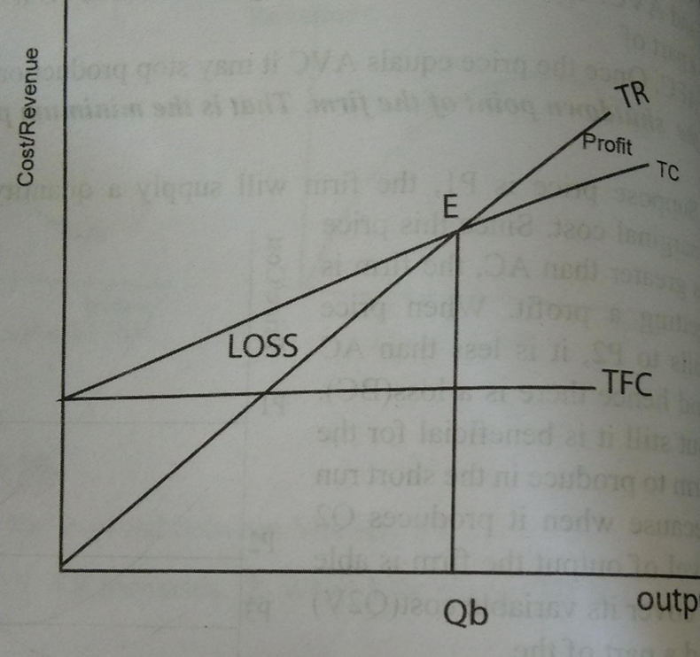
TR intersects TC at E
E is the BEP
Gap between TC and TR beyond E shows profit
Gap between TC and TR below this point shows loss

Slide 62
At break even point, TR=TC
or PxQb =TFC+TVC
PxQ = TFC + (AVCxQ)
PxQ – AVCxQ=TFC
Thus BEP Q= TFC
P-AVC

Slide 63
Contribution => sales – variable cost
P/V ratio => contribution or S – V
sales S
BEP
- (in units) => TFC
Price-AVC
- (in rupees) => TFC or TFC x S
P/V ratio S – V
Sales to earn a desired profit = TFC+desired profit
P/V ratio
Profit = TR – TC
At BEP, TR = TC

Slide 64
1.) A firm pays Rs. 3000 rent and another Rs3000 as interest every month. Selling price of the product is Rs.5 and variable cost per unit is Rs2
Find break even level of output
BEP (in units) = TFC
P-AVC
= 2000 units
Find profit, if sales is 5000
Profit = TR – TC
= 9000/-
To get a profit of 15000/- what should be output?
Profit = TR – TC
15000 = 5Q – (6000+2Q)
= 7000 units

Slide 65
d) If sales = 5000, derive the margin of safety
Margin of safety = sales – BE sales
= 3000 units
e) Find profit volume ratio and break even sales
P/V ratio = contribution
sales
= 0.6 or 60%
f) To bring down break even output to 1500 units, what price should be charged?
1500 =6000
P -2
=Rs.6

Slide 66
2) Use the following information to calculate (a) break even point in units and in rupees (b) the output required in order to earn profit of Rs. 90000
Monthly rent = 70,000
Monthly interest = 2000
Variable cost = 15/unit
Selling price = 24/unit
(a) BEP (units) = TFC
P – AVC
= 8000units
BEP (in rupees) = TFC or 8000 x 24
P/V ratio
= Rs.1,92,000

Slide 67
(b) Number of units to be sold to earn profit of Rs. 90,000
profit = TR – TC
90000 = (PxQ)-(TVC+TFC)
= 18000units
or FC+desired profit
S-V
= 18000 units

